Slide 1
Road Safety Assembly
Notes:
Road Safety - A Virtual Assembly

Slide 2
At what age do you first become a Road User?
Notes:
For most people it's from birth. Nearly all people make their first journey as a new-born baby coming home from hospital

Slide 4
Green Cross Code
Notes:
So .... Where to start
You might have heard of the Green Cross Code
It's a method to remember a safe way to cross the road

Slide 5
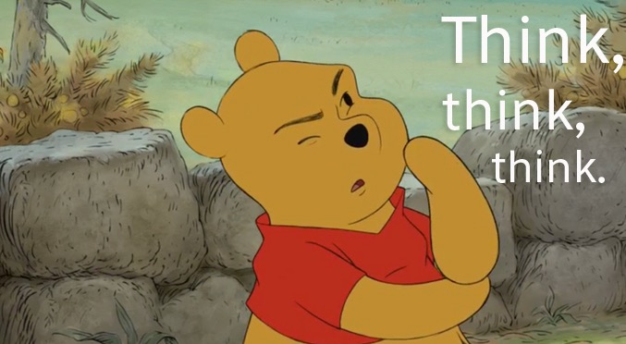
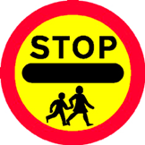
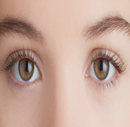
Notes:
First thing you do ..... Think! ....Where am I - Where is a safe place to cross the road
Then ..... Stop - Stand on the pavement near (but not right on) the kerb
Look! Look all around for traffic - left, right and left again
Listen - for approaching vehicles or bikes
When it's safe cross the road - go straight (shortest route) and DON"T RUN
Keep looking and listening as you cross

Slide 7
Think! asked some school children to show you how it’s done
Notes:
Think! Road Safety asked some school children to show you

Slide 10
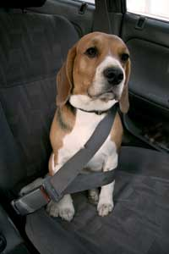
Seatbelts
Notes:
It’s been the law for a long time that you have to wear a seatbelt in a vehicle if they are fitted, but it hasn’t always been the case
Cars didn’t always have to have seatbelts. It took people a while to realise how many lives could be saved. Drivers had to wear seatbelts from 1983. Everyone else in a car were required to use them from 1991 onwards
It should be automatic for you to put your belt on. Tell the driver if you haven’t managed to get yours on so they don’t drive off. If you notice younger brothers or sisters struggling with doing up a belt or taking it off while you are being driven – tell the driver ASAP

Slide 11
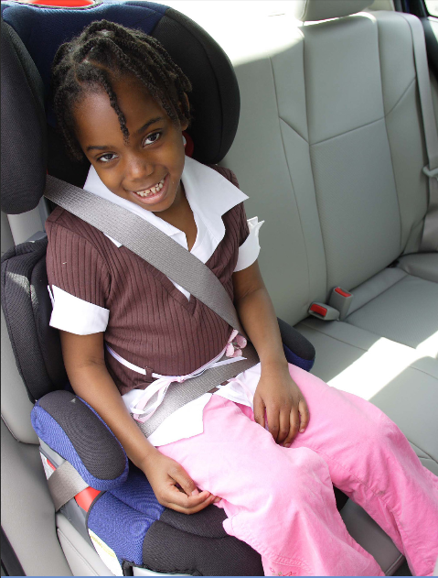
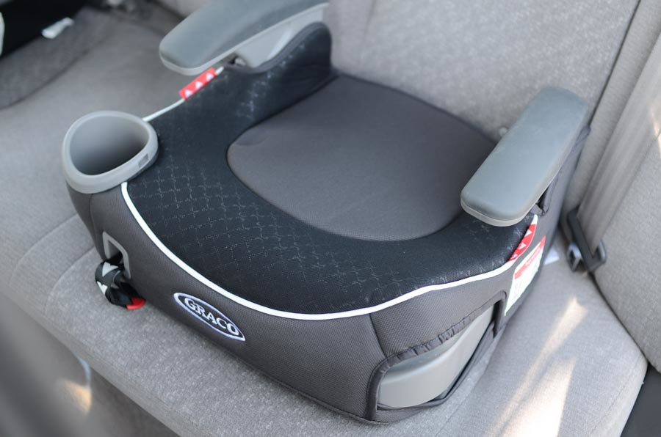
Booster seats and car seats
Notes:
You must normally use a booster car seat until you reach 12 years old or grow to 135 cm tall, whichever comes first.
However, we recommend that you use a booster until you reach that height. They are designed especially for children and make seatbelts made for full sized adults work better for children

Slide 12
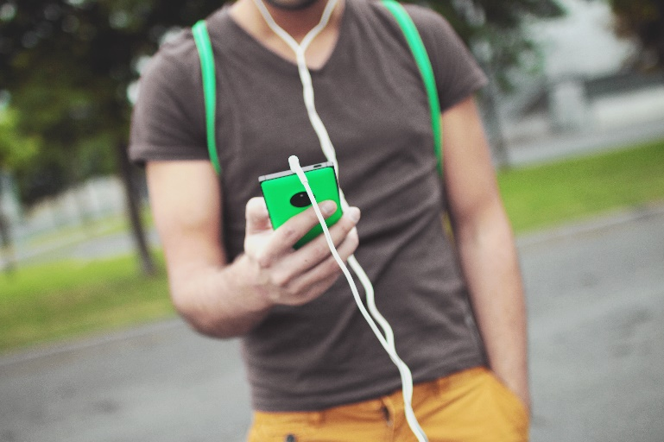
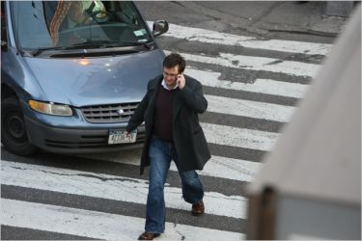
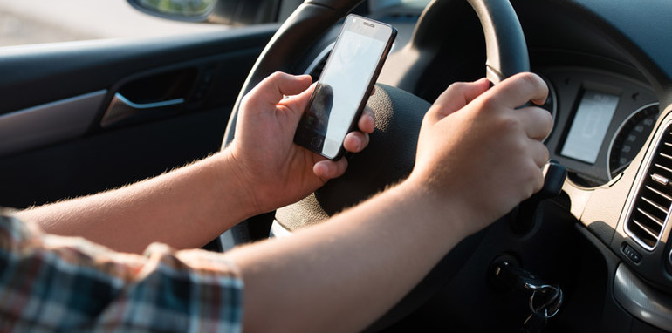
Mobile Phones
Notes:
Mobile phones – lots of people have them and they are great for all sorts of things – music, pictures, social media, texts and messages – oh yes and making phone calls
But when you’re plugged in listening to music you are far less aware of what is going on around you and it can be really dangerous as you are so distracted
Car drivers are also vulnerable to distractions caused by using their phones. It’s illegal to hold a phone while driving although you can use Bluetooth connections – get caught and it’s a £200 fine and 6 points on a licence –
To see just how absorbed people get – check this out

Slide 13
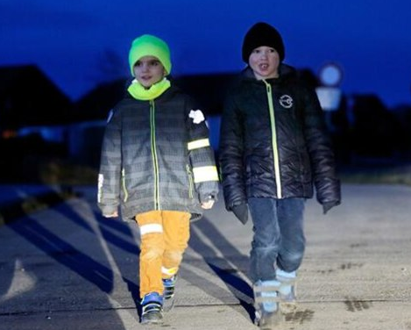
Don’t Be these Be these ones… children…
Notes:
How many times have you seen something like this? He’s lucky – bruised pride BUT what if he had stepped off the kerb into the path of a car?

Slide 14
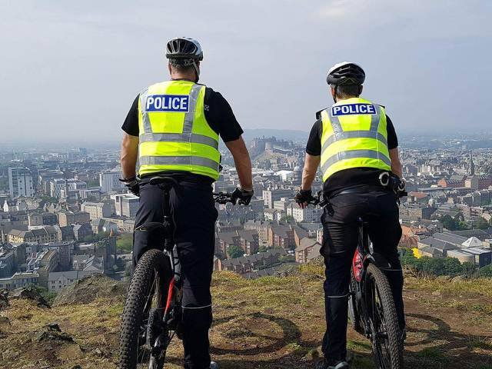
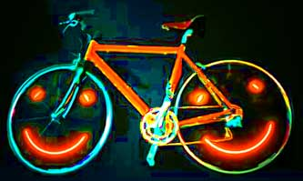
Bikes and Scooters
Notes:
For those of you that use a bike or a scooter – some safety tips
Firstly – get and use a cycle helmet and look after it
Wear bright clothing – High Viz if you can – particularly in winter when it’s dark early
Get some lights – check they work BE SAFE BE SEEN

Slide 15
Any Questions? RoadSafety.Education@centralbedfordshire.gov.uk
Notes:
Ordinarily we love to be able to answer your questions but at the moment that’s not possible right now. But if you do have any questions on what we’ve shown you, talk to your teachers who can send us an email and we’ll do our best to give you an answer.
Thanks for listening and stay safe out there

