Slide 1
Who am I?
Teacher for 15 years
Tutor
Foundation Certificate in Psychodynamic Counselling
Coach training

Slide 2
How can we best support our children in the post-COVID world?

Slide 3
Resilience
Mental Fitness

Slide 4
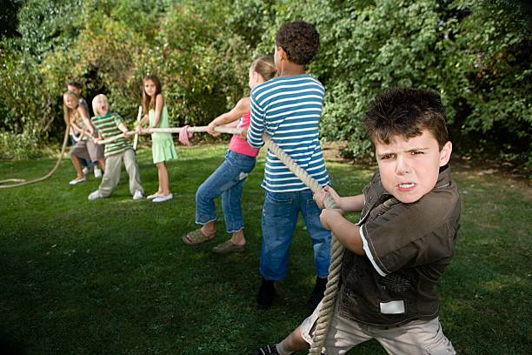
FROM THIS:

Slide 5
TO THIS:

Slide 6
Saboteur Interceptor
Self-Command
Sage
Mental Fitness

Slide 7
Saboteur Interceptor
Self-Command
Sage
Mental Fitness

Slide 8
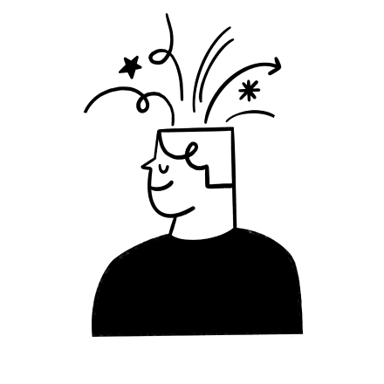
What are some of the negative stories you’ve told yourself this morning?

Slide 9
I got angry with my children so I’m a bad parent.
I haven’t got any nice clothes so always look uglier than everyone else.
My child struggles at school more than everyone else so I’m not doing a good enough job.
My hair is a mess - my whole life is a mess.
I haven’t prepared properly for my meeting - everyone is going to think I’m useless at my job.
We’re late for school - my whole day is going to be rubbish now.

Slide 10
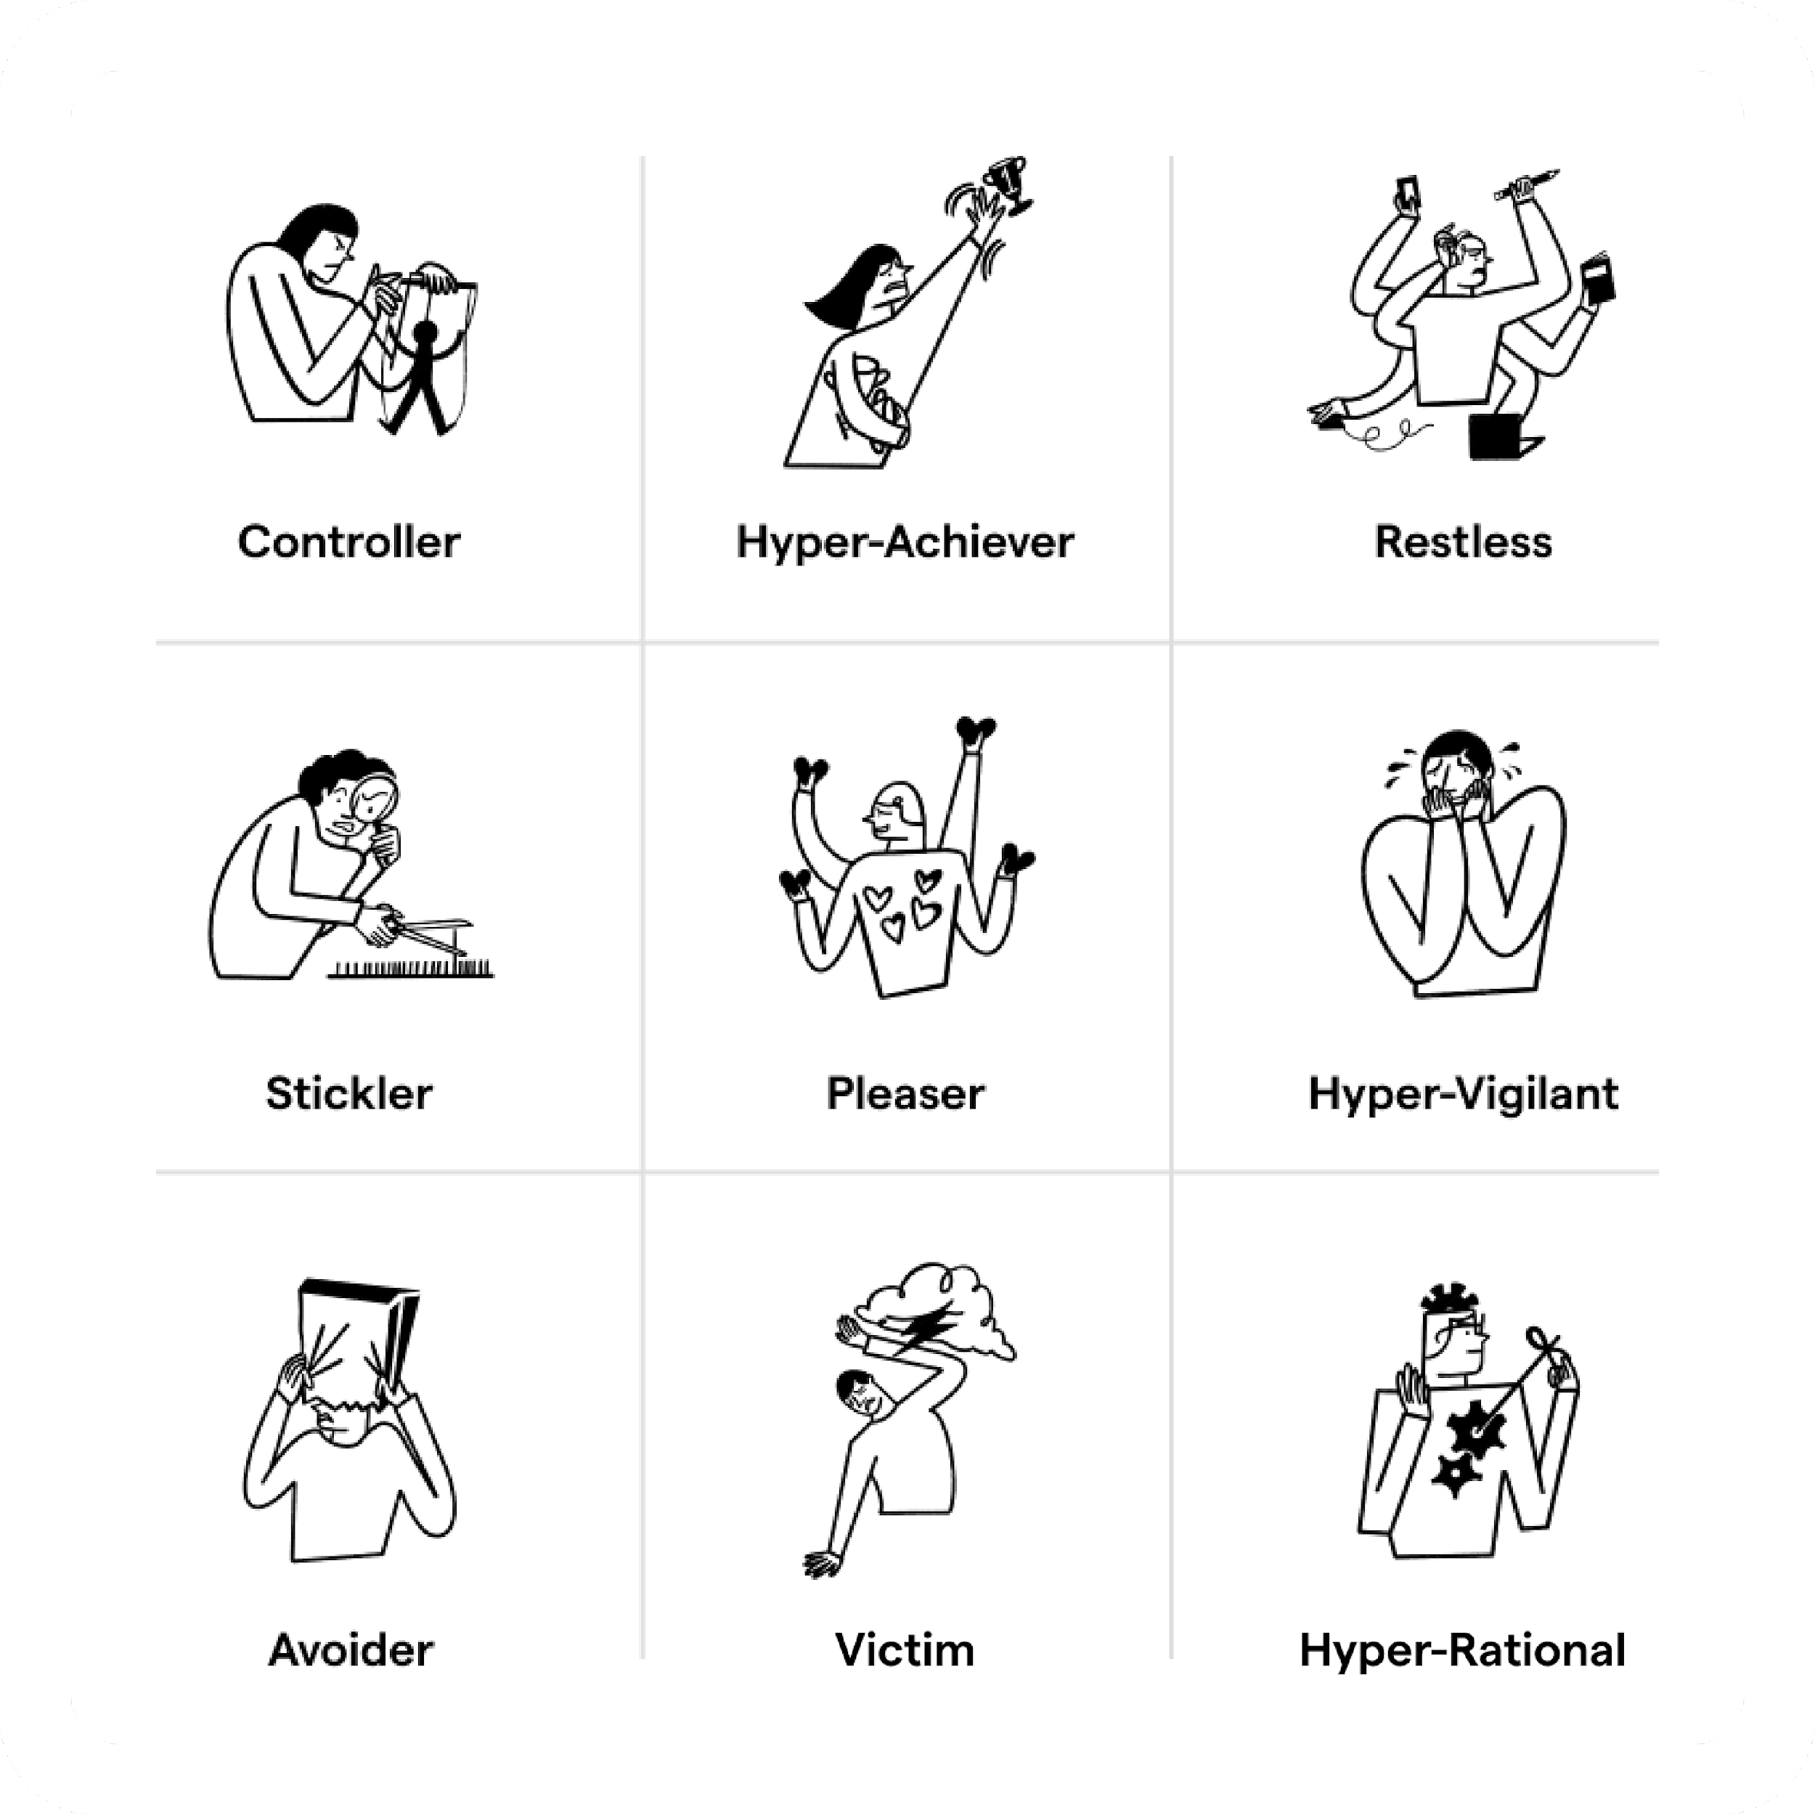
Accomplice Saboteurs

Slide 11
…should
…can’t
Saboteur Intercept
How can we notice them?
…not good enough

Slide 12
Saboteur Interceptor
Self-Command
Sage
Mental Fitness

Slide 13
10-Second PQ Reps
©2022 Positive Intelligence, LLC

Slide 14
Saboteur Interceptor
Self-Command
Sage
Mental Fitness

Slide 15
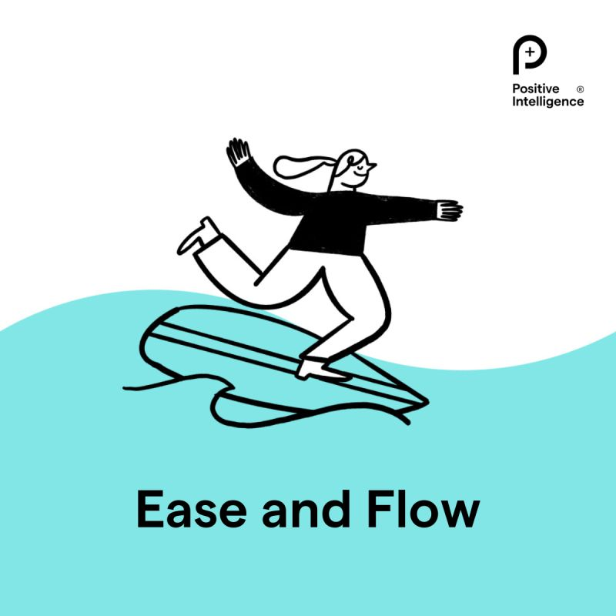
SAGE

Slide 16
Empathy Power
What’s the kindest thing you can say to yourself today?

Slide 17
Ripple Effect

Slide 18
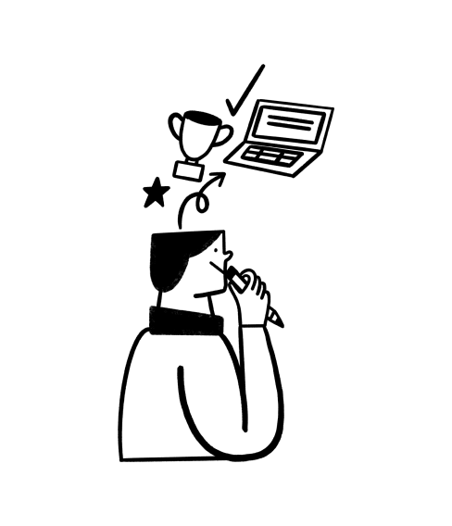
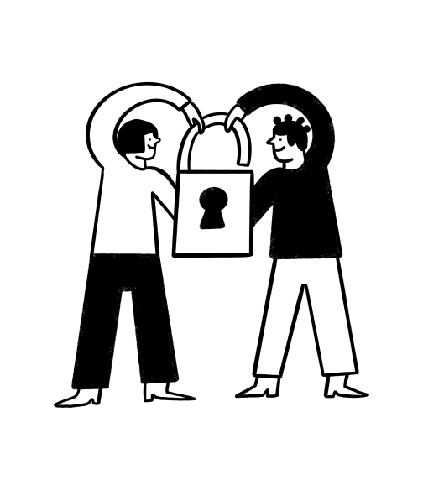
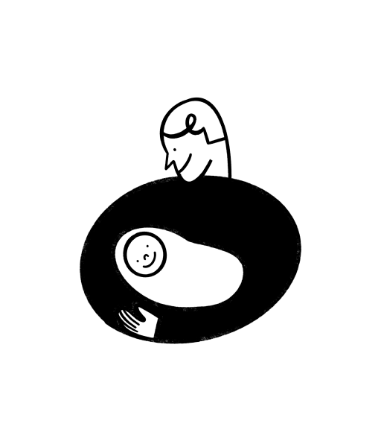
How can you start applying this today?

Slide 19
How can you work with me?
1:1 Coaching
Walk and Talk
Accountability Coaching
PQ training - individuals and groups
10% discount for Russell Parents
Follow QR code to find out more

