Slide 1
Science Week 11th – 20th March
STEM
science
technology engineering
maths
Can anyone be a scientist?

Slide 2
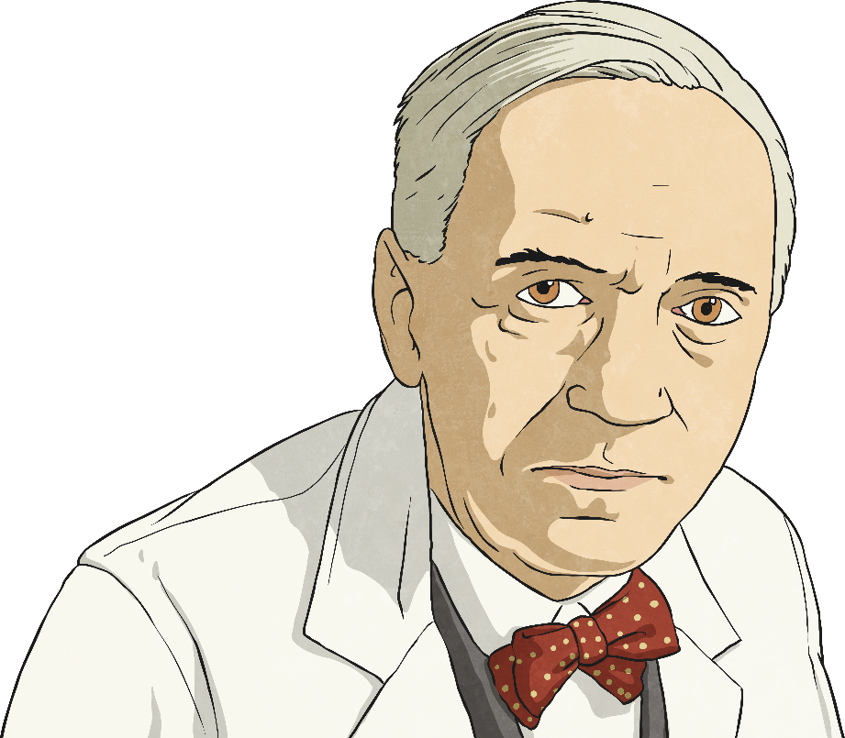
Who Is This?

Slide 3
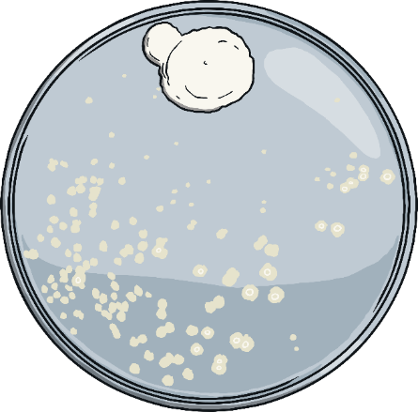
Alexander Fleming
Alexander Fleming saved millions of lives by discovering the antibiotic, penicillin. He discovered it by observing mould keeping bacteria away.

Slide 4
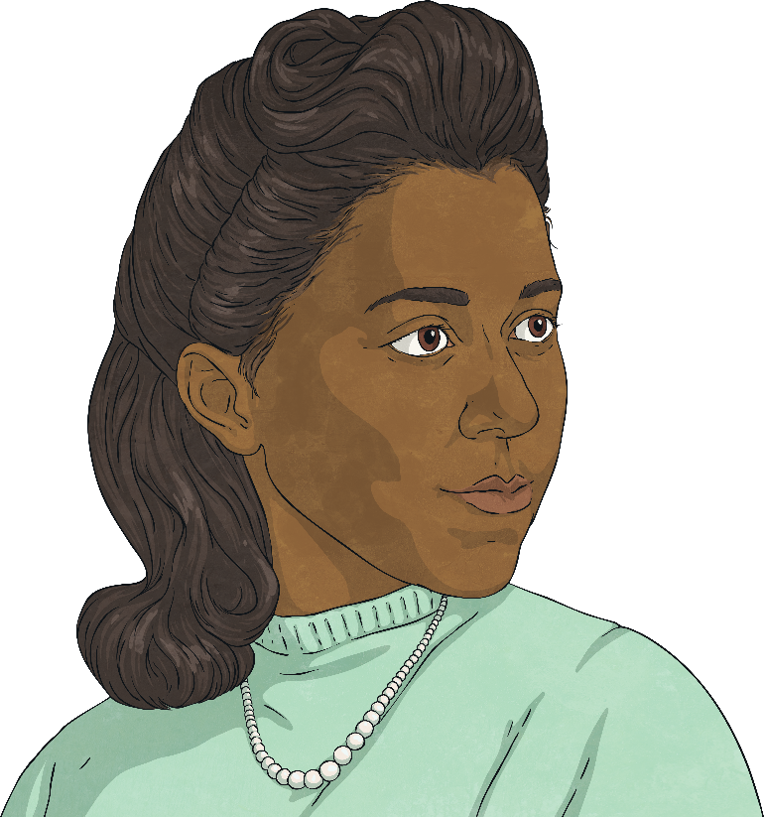
Who Is This?

Slide 5
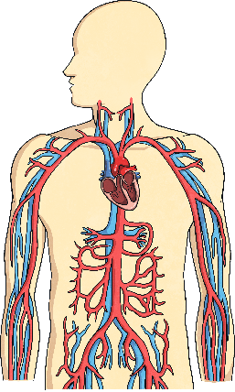
Marie M. Daly
Marie M. Daly’s research helped us to understand how the human body works.
She examined how proteins are made in the body as well as discovering the relationship between high cholesterol and clogged arteries. This led to new understanding of how food and diet affect the circulatory system
and the heart.

Slide 6
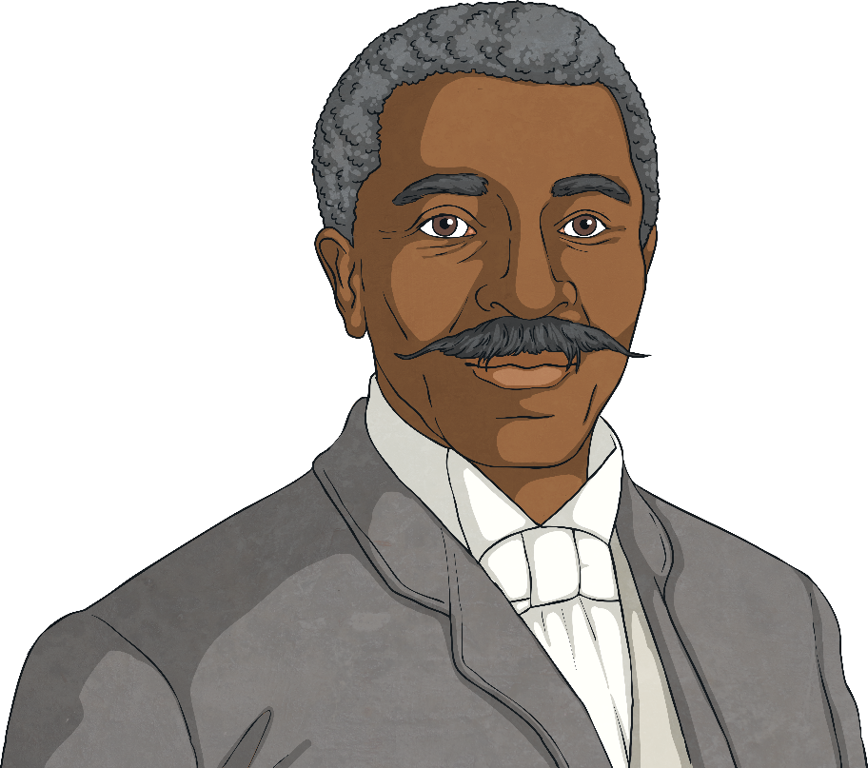
Who Is This?

Slide 7
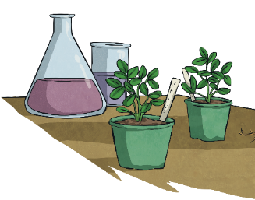
George Washington Carver
George Washington Carver was an American scientist and teacher who is famous for many agricultural discoveries and inventions.
Born into slavery, Carver went on to become a brilliant botanist and later devised more than 300 ways in which to use the peanut.

Slide 8
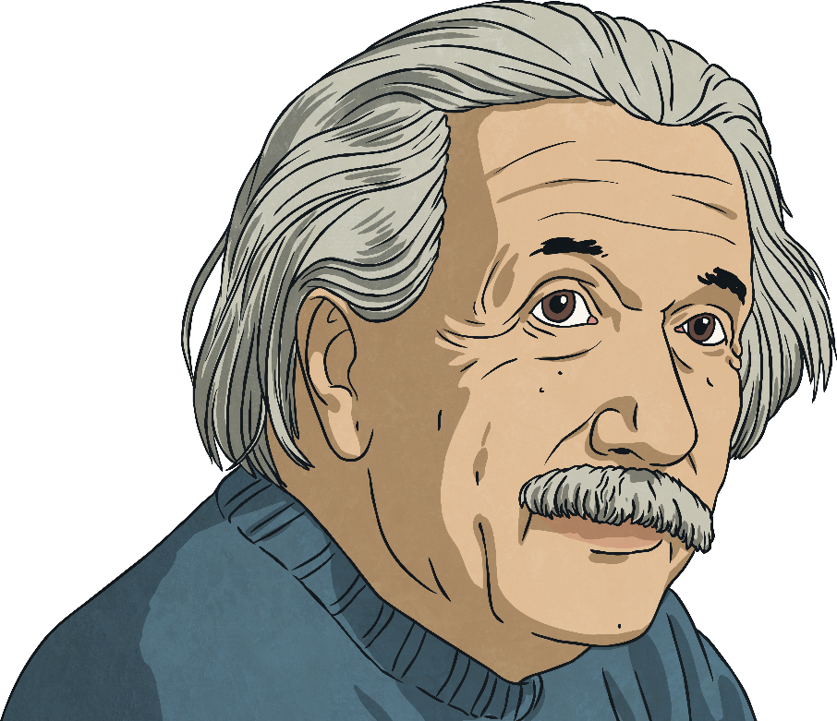
Who Is This?

Slide 9
Albert Einstein (died 1955)
Albert Einstein completely changed the way we understand many things, including rewriting the law of gravity and discovering the famous equation:
E=mc²

Slide 10
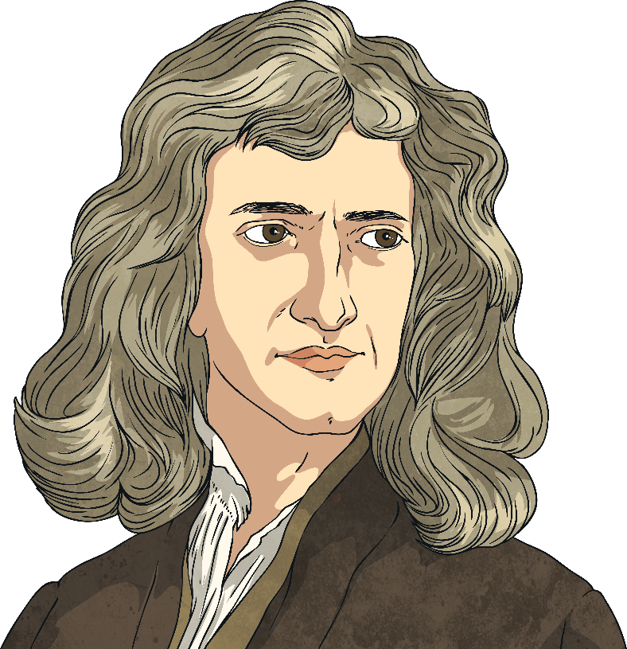
Who Is This?

Slide 11
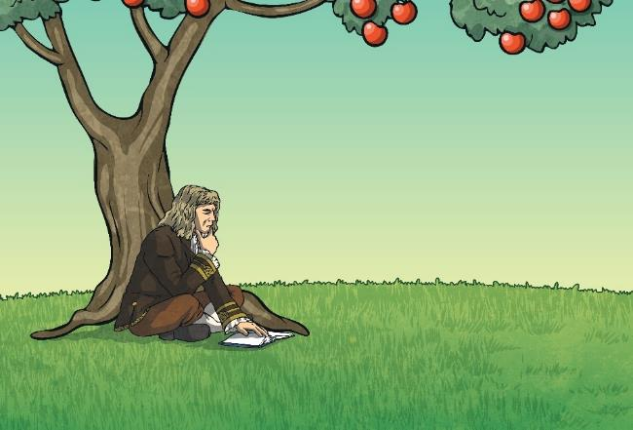
Sir Isaac Newton
Isaac Newton is perhaps one of the greatest scientists that ever lived. He discovered gravity, built the world’s first reflecting telescope and showed that the colours of the rainbow make up sunlight.

Slide 12
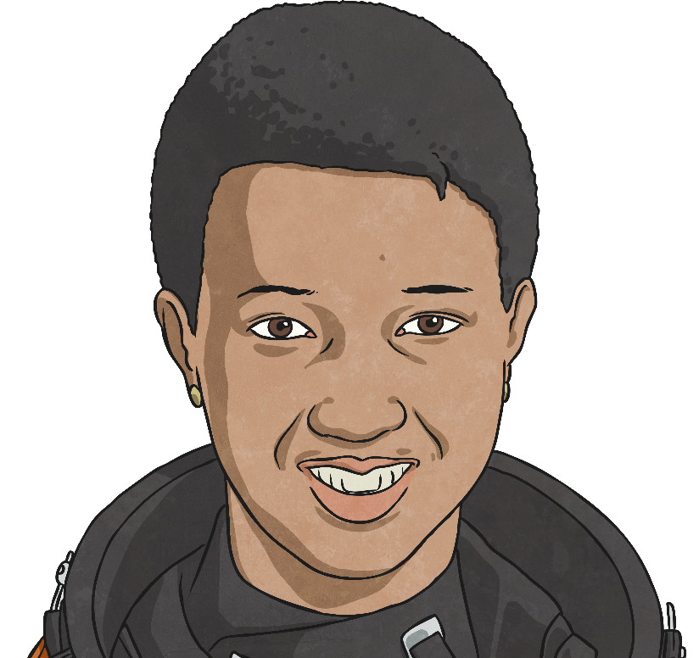
Who Is This?

Slide 13
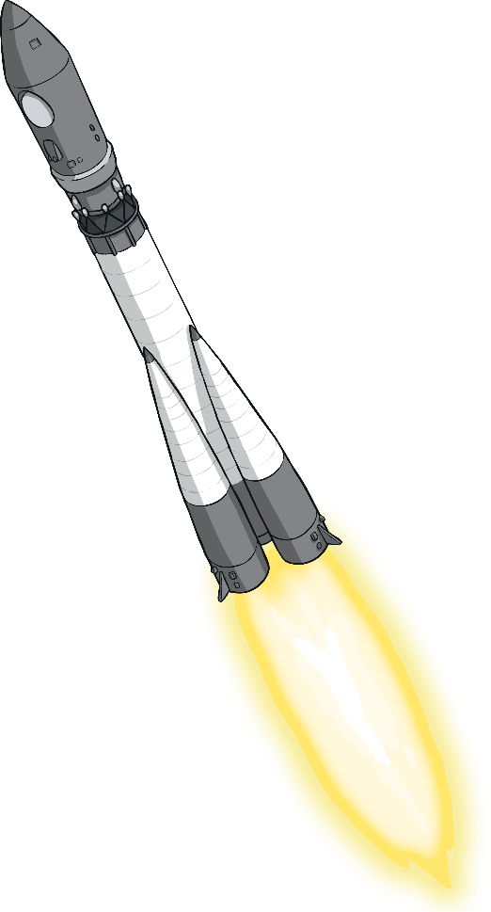
Mae Jemison
In 1992, Mae Jemison became the first Black American woman to travel to space. Jemison first trained as a doctor and worked as a medical officer for the Peace Corps.
During her time in space, Jemison conducted lots of experiments, earning herself a number of awards such as the 1988 Essence Science and Technology Award.

Slide 14
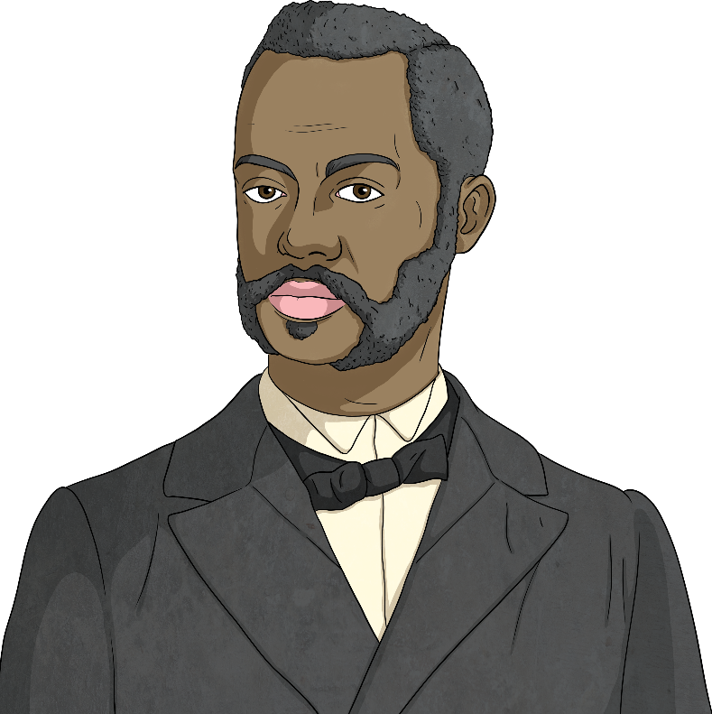
Who Is This?

Slide 15
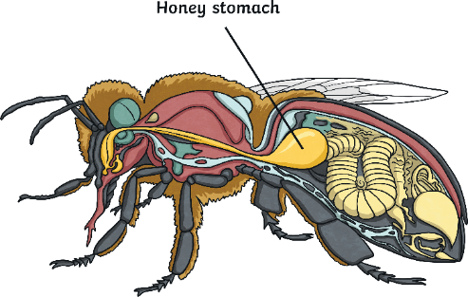
Charles H Turner
Charles H. Turner was a behavioural scientist whose research focused on animal behaviour.
Turner is most famous for his discovery that insects can hear. Through his research, he also found that honeybees could recognise colours and patterns and have some idea of time.

Slide 16
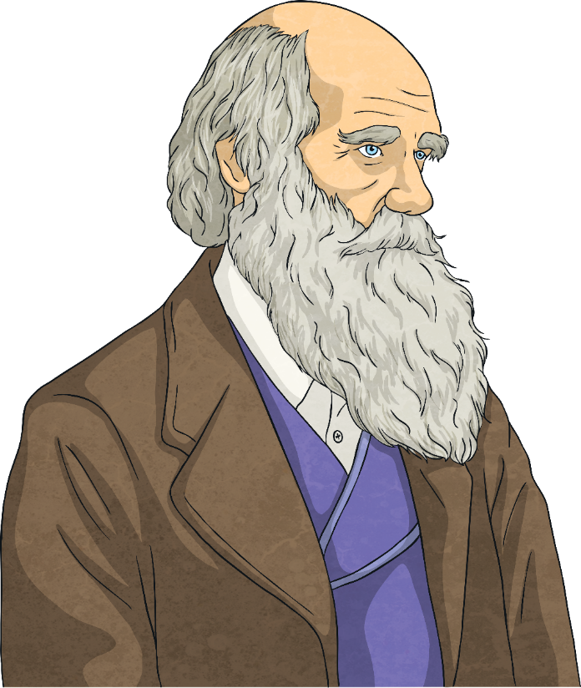
Who Is This?
Who Is This?

Slide 17
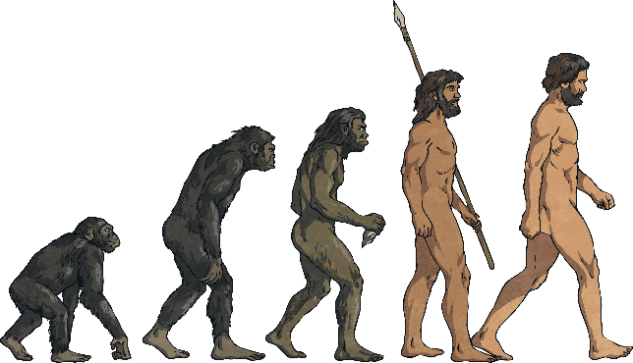
Charles Darwin (1809-1882)
Charles Darwin was a famous English naturalist, biologist and geologist.
He is known mainly for his work on the theory of evolution. This is the idea that all different species have evolved from simple forms – including the theory that humans evolved from apes.

Slide 18
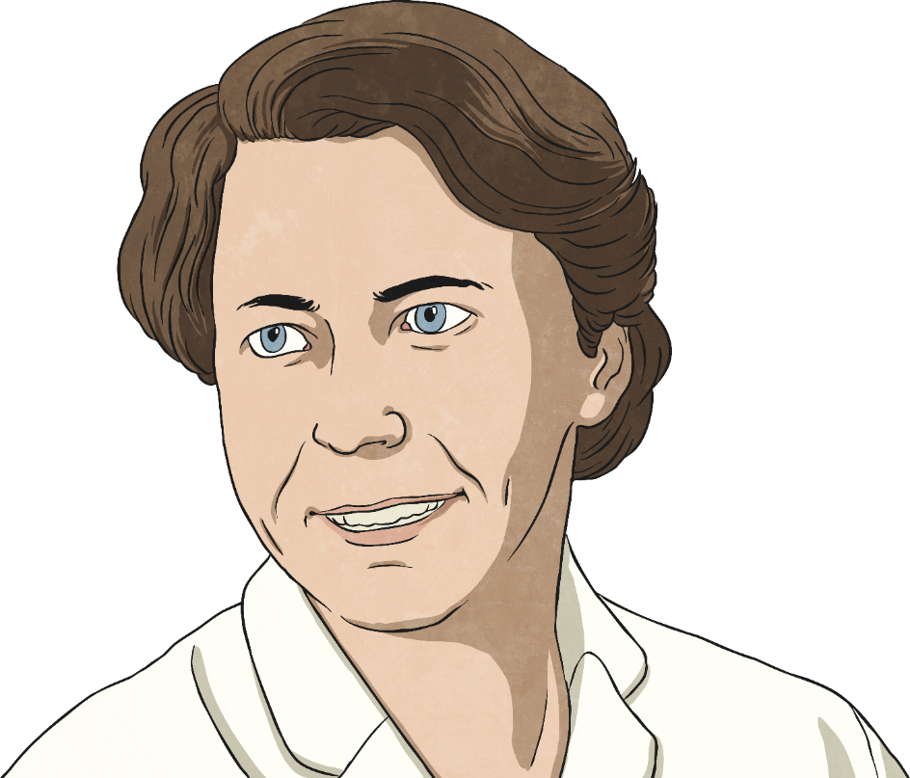
Who Is This?
Who Is This?

Slide 19
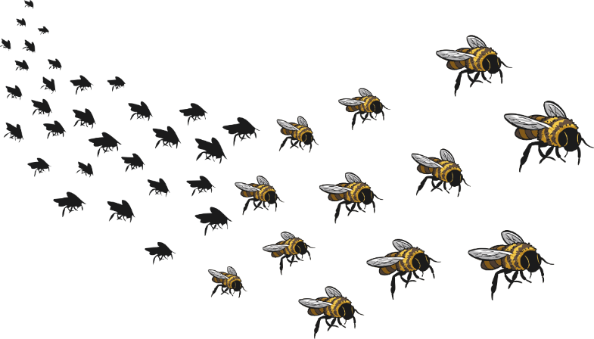
Eva Crane
Eva Crane was a scientist that studied bees, becoming a world expert on them. Between 1960 and 2000, Crane visited many countries to research different ways of caring for bees and the differences between species of bees.

Slide 20
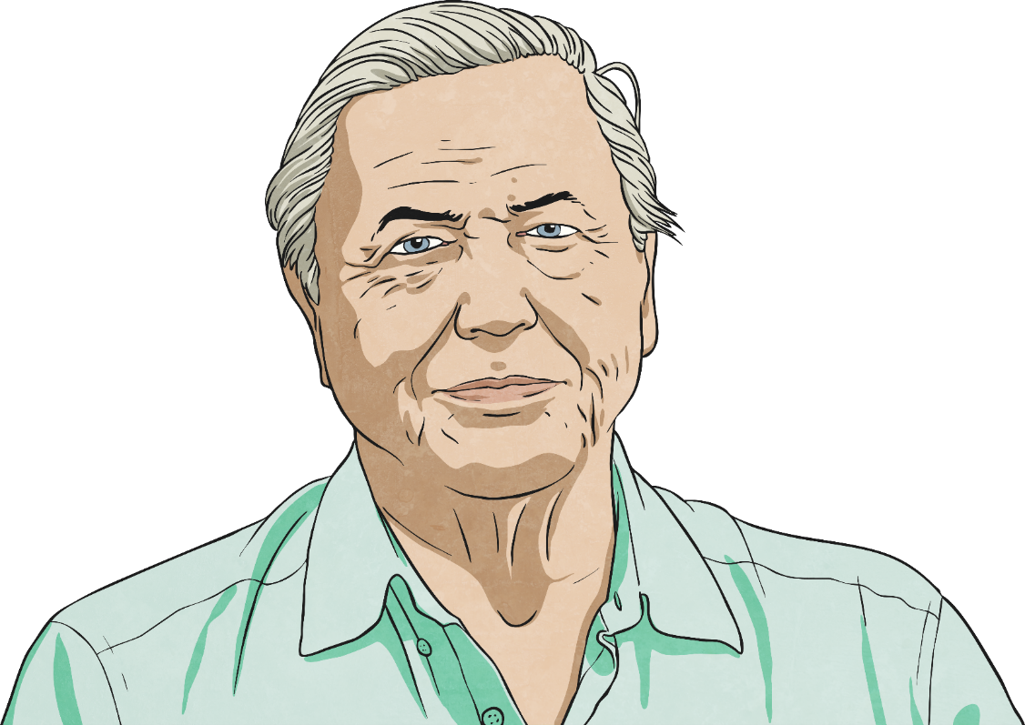
Who Is This?
Who Is This?

Slide 21
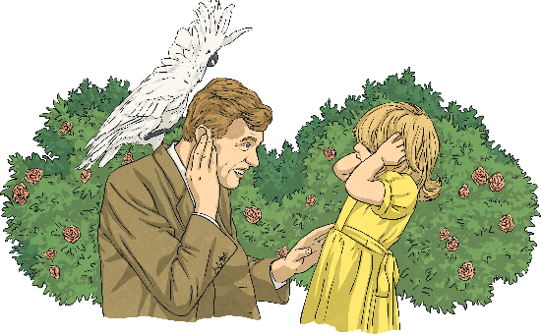
Sir David Attenborough
David Attenborough is a scientist who studies animals and their behaviour. He has been making natural history and wildlife documentaries for over sixty years.

Slide 22
Engineers at Lockheed Martin
People of Lockheed Martin: Meet Jared
Name: Jared
Years at Lockheed Martin: 6 years
What is your current position? Systems Engineer
What are your day-to-day responsibilities? System design & architecting, guidance, navigation & control design and development and system performance testing.
Can you tell us why you volunteer?
I found an organization called Guys with Ties Philanthropy which partners up with local charities and helps them raise money by throwing fun fundraisers. Over my three years with the organization, I have moved up the ranks and am now Vice President of the Board of Directors

Slide 23
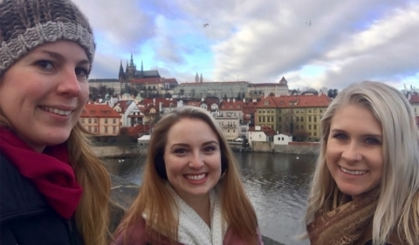
Planners at Lockheed Martin
Name: Eva
Years at Lockheed Martin: 4 years
What is your current position? Program Planner
What are your day-to-day responsibilities? I collaborate with my engineering, production operations, subcontracts and business management teammates to develop and execute schedules that help the team achieve mission success!

Slide 24
These engineers has been pulled together to ramp up the supply of disposable respirators.

Slide 25
These four scientists/ engineers talk about collaboration in their job.
Lets hear what they have to say.
https://www.britishscienceweek.org/smashing-stereotypes-technology-guardians/

Slide 26
Marine Biologists – coming to year 1

Slide 27
A vet has visited Robins and Kingfishers.

Slide 28
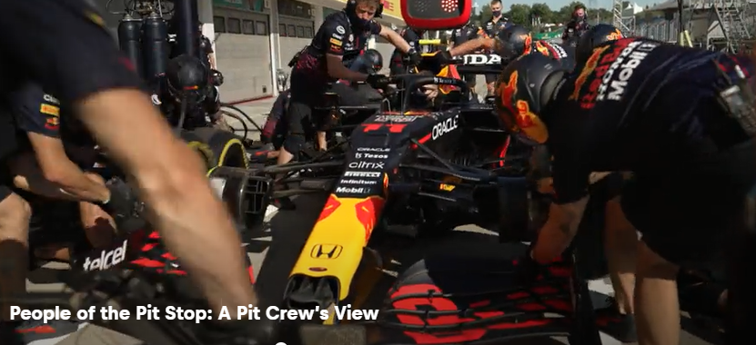
Red Bull Racing
Engineers constantly strive to improve parts of the car either mechanical or electrical. Plus much more.

Slide 29
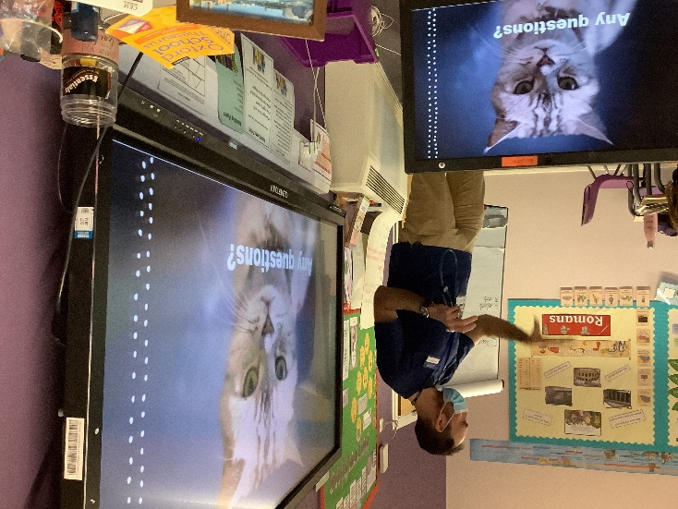
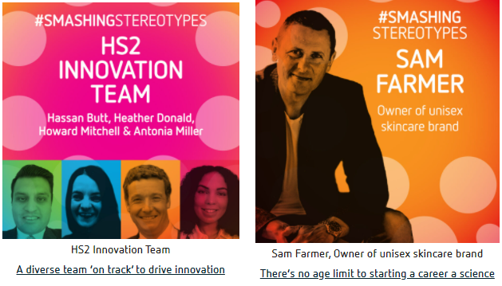
The possibilities for your future are endless.
Don’t forget your science
selfies.

